Slide 1

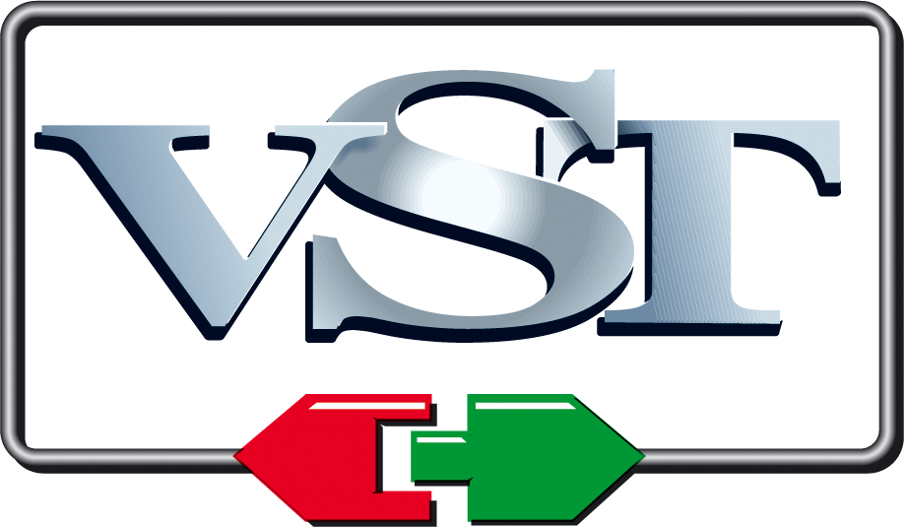
JUCE and VST

Slide 2

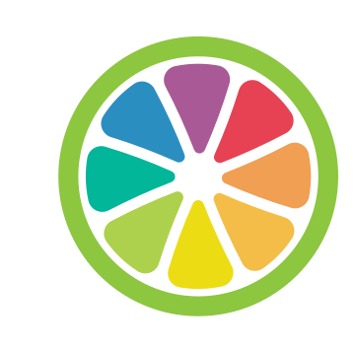
JUCE - Jules' Utility Class Extensions
Created in 2004 by Jules Storer
Open source cross-platform C++ codebase for developing desktop and mobile applications, & plug-ins
Used to write software so it runs with same user experience on many platforms & in many formats
contains classes covering many other commonly used features
UI elements, graphics, audio, XML & JSON parsing, networking, cryptography, multi-threading…
reduces number of third-party libraries needed
Supports Windows, macOS, Linux, iOS and Android operating systems
Notes:
JUCE (Jules' Utility Class Extensions) was created in 2004 by Jules Storer. It is an open source cross-platform C++ codebase for developing desktop and mobile applications, & plug-ins. It is used to write software so that it will run with the same user experience on many platforms (Windows, macOS, Linux, iOS Android…) and in many formats. It furthermore contains many classes covering commonly used features by apps and plug-ins; user interface elements, graphics, audio, XML parsing, networking, cryptography, multi-threading… Thus, it also reduces the number of third-party libraries needed.

Slide 3
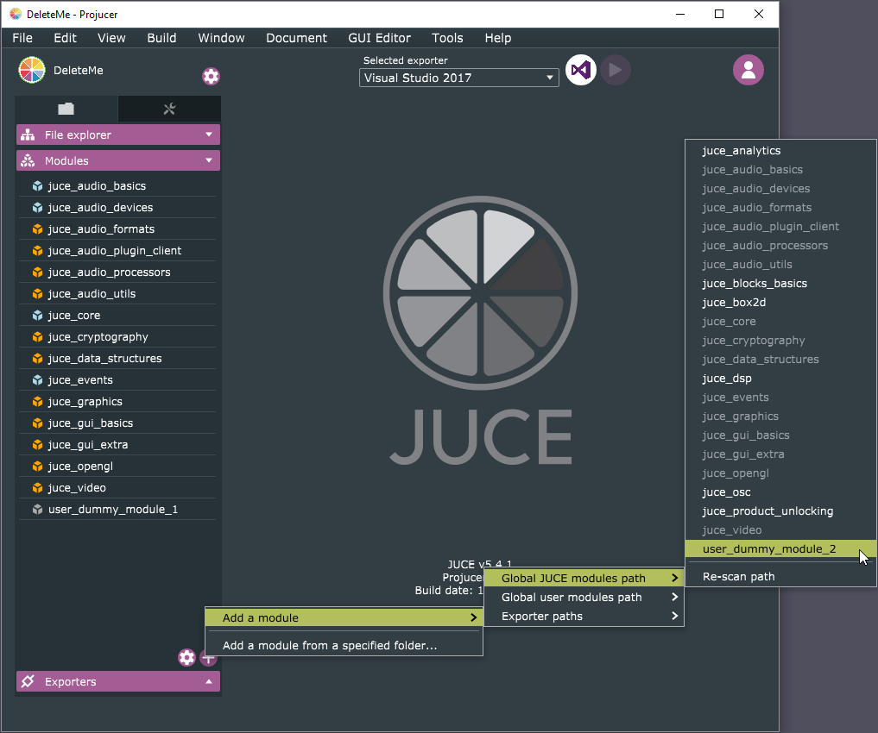
The Projucer
JUCE’s build configuration tool for creating and managing JUCE projects
Once files and settings for JUCE project specified, it automatically generates 3rd-party project files to allow project to compile natively on each target platform
Visual Studio, Xcode, Android Studio, CodeBlocks and Linux Makefiles
Also has code editor, integrated GUI editor, wizards for creating new projects and files
Notes:
The Projucer is JUCE’s build configuration tool for creating and managing JUCE projects. Once files and settings for a JUCE project are specified, it automatically generates 3rd-party project files to allow project to compile natively on each target platform; Visual Studio, Xcode, Android Studio, CodeBlocks, Linux Makefiles… The Projucer also has a code editor, integrated GUI editor, and wizards for creating new projects and files.

Slide 4
JUCE and audio
Most widely used framework for audio application and plug-in development
Large audio functionality
Support for audio devices (such as CoreAudio, JACK, DirectSound) and MIDI playback, DSP building blocks, polyphonic synthesizers…
built-in readers for common audio file formats (WAV, AIFF, FLAC, MP3, Vorbis…)
Comes with wrapper classes for building audio plugins
Single binary produced that supports multiple audio plugin formats
Supports VST, VST3, AU, AUv3, AAX, LV2 … plug-in formats
Use in DAWs like Logic, Live, Pro Tools, FL Studio or Cubase
Since all platform and format-specific code is contained in the wrapper, user can build for almost any plug-in format & platform from single codebase
Notes:
But the real reason why we focus on JUCE here is that it is the most widely used framework for audio application and plug-in development. As mentioned, JUCE has a very large number of built-in libraries, but this is especially true for those related to audio functionality. JUCE has support for audio devices (CoreAudio, JACK, DirectSound) and MIDI playback, DSP building blocks, polyphonic synthesizers…, and built-in readers for common audio file formats (WAV, AIFF, FLAC, MP3, Vorbis…). It also comes with wrapper classes for building all major audio plugin formats. Since all platform and format-specific code is contained in the wrapper, one can build for almost any plug-in format & platform from a single codebase.

Slide 5
Basic JUCE audio plug-in components and their relationship to the DAW
PluginEditor
PluginProcessor
GUI Handlers
Parameter Controls
GUI
sliderValueChanged()
...and other control types
timerCallback()
called periodically by system
setValue()
getValue()
Init. and Cleanup
DAW
prepareToPlay()
releaseResources()
called once before starting
called once after finishing
Audio Callback
called continuously while running
processBlock()
Notes:
Now we can dive into the details of an audio plugin.

Slide 6
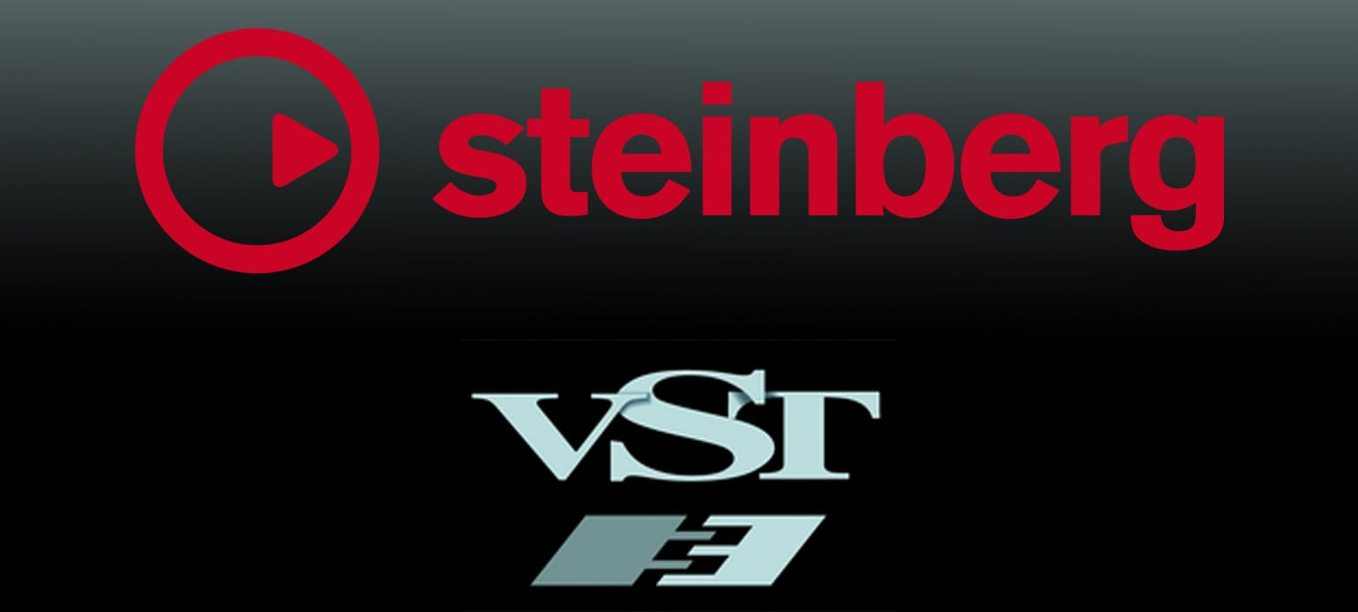
VST – Virtual Studio Technology
Created by Steinberg in 1996
Steinberg, creators of Cubase, Nuendo, … owned by Yamaha since 2005
audio plug-in software interface
integrates software synthesizers & effects units into digital audio workstations
Often uses digital signal processing to simulate traditional recording studio hardware
Main industry standard for audio plug-ins
Notes:
The most popular audio plugin format is VST, which stands for Virtual Studio Technology . VST was created by Steinberg (now owned by Yamaha) in 1996
Steinberg, creators of Cubase, Nuendo, … owned by Yamaha since 2005
VST is an audio plug-in software interface. That is, it is an audio plugin standard that allows virtual instruments and effects (and more, as we will see) to be integrated into digital audio workstations. It is the main industry standard for audio plug-ins

Slide 7
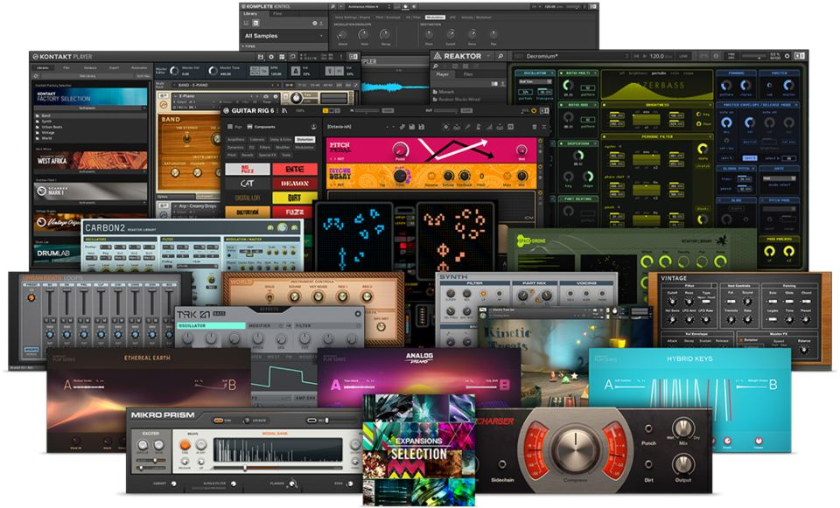
Overview of VST plugins
usually run within digital audio workstation (DAW)
provide additional functionality
standalone plugin hosts also exist that support VST
usually have graphical user interface that displays controls similar to physical switches and knobs on audio hardware
Most are either instruments (VSTi) or effects (VSTfx)
other categories exist, e.g spectrum analyzers and various meters
Notes:
VST plug-ins usually run within digital audio workstation (DAW), though stand-alone plug-in hosts also exist that can host VST plug-ins but lack most DAW features. VST plug-ins are intended to provide additional functionality to the host, and they often use digital signal processing to simulate traditional recording studio hardware. VSTs usually have graphical user interfaces that display controls similar to physical switches and knobs on audio hardware.
Most VSTs are either instruments (VSTi) or effects (VSTfx), though other categories exist, e.g spectrum analyzers and various meters.

Slide 8
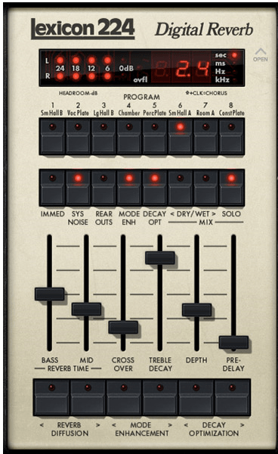
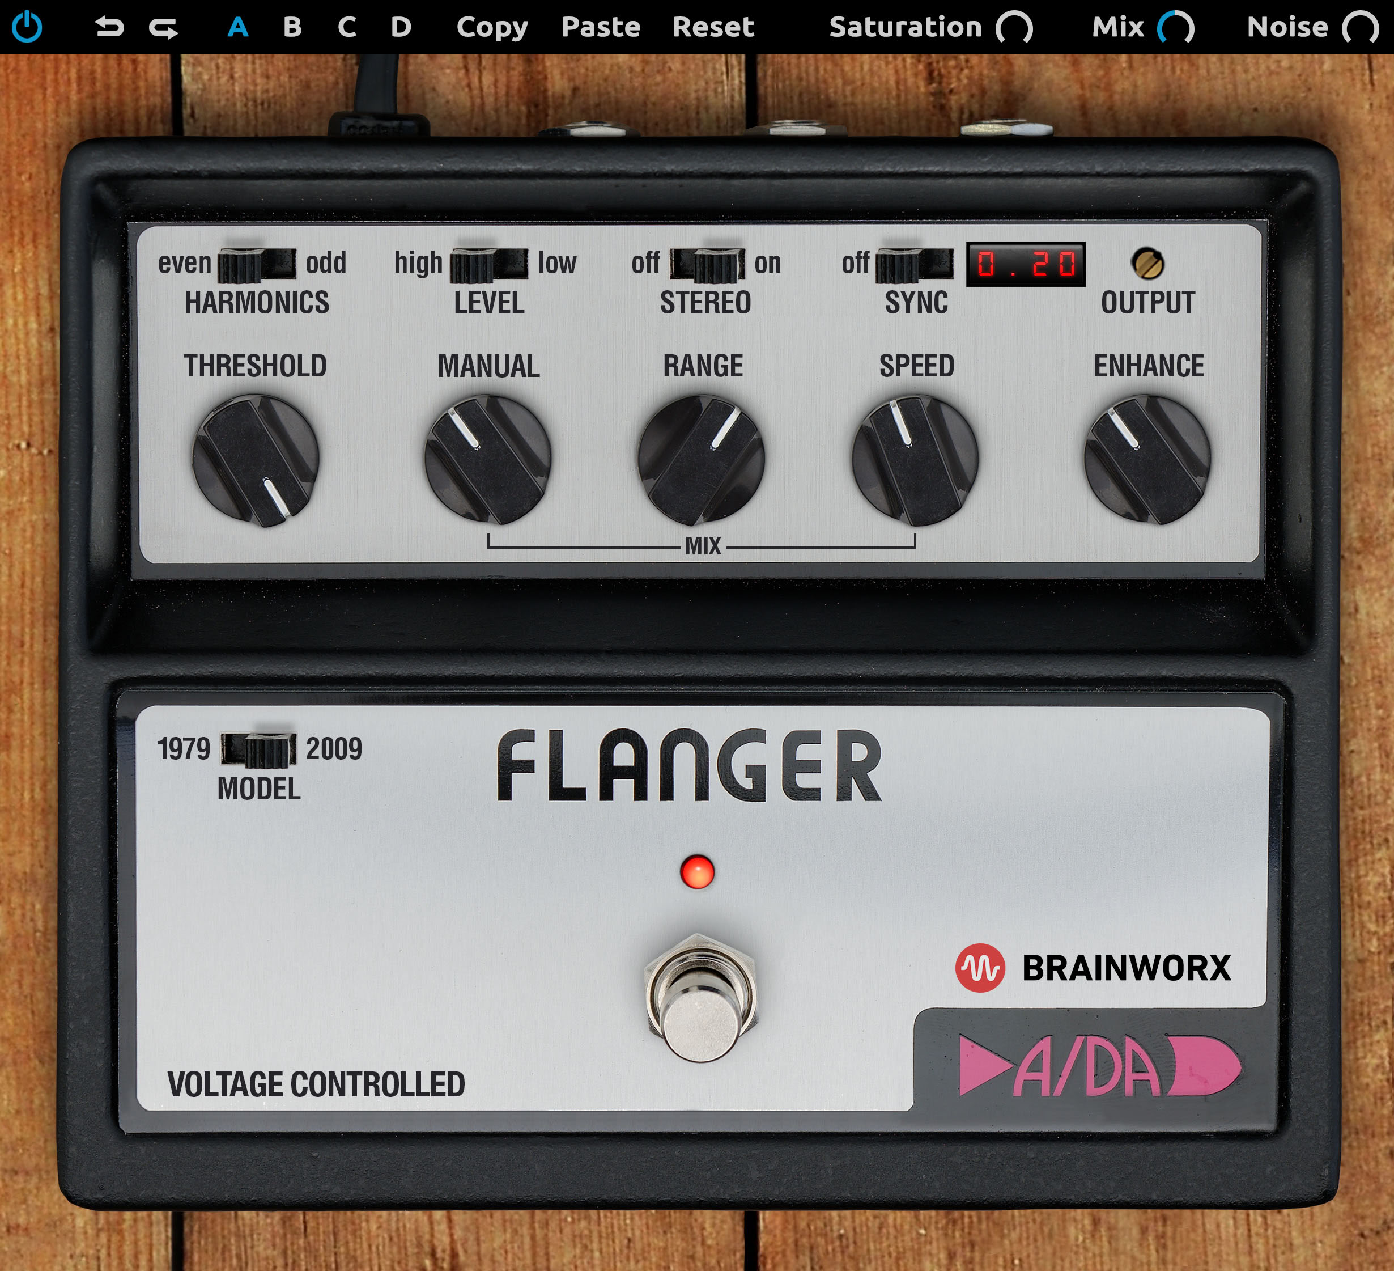
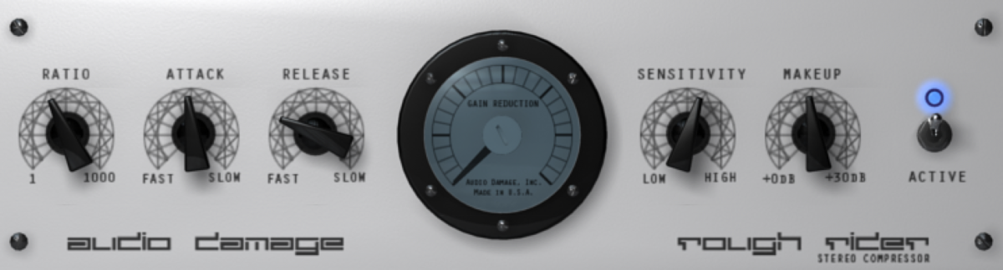
VST effects (VSTfx)
VST effects process audio
receive digital audio and process it through to their outputs
perform same functions as hardware audio processors
Chaining
most hosts can route audio output from one VST to input of another
For example, output of VST synthesizer can be sent through reverb effect
Notes:
VST effects process audio
receive digital audio and process it through to their outputs
perform same functions as hardware audio processors
Chaining
most hosts can route audio output from one VST to input of another
For example, output of VST synthesizer can be sent through reverb effect

Slide 9
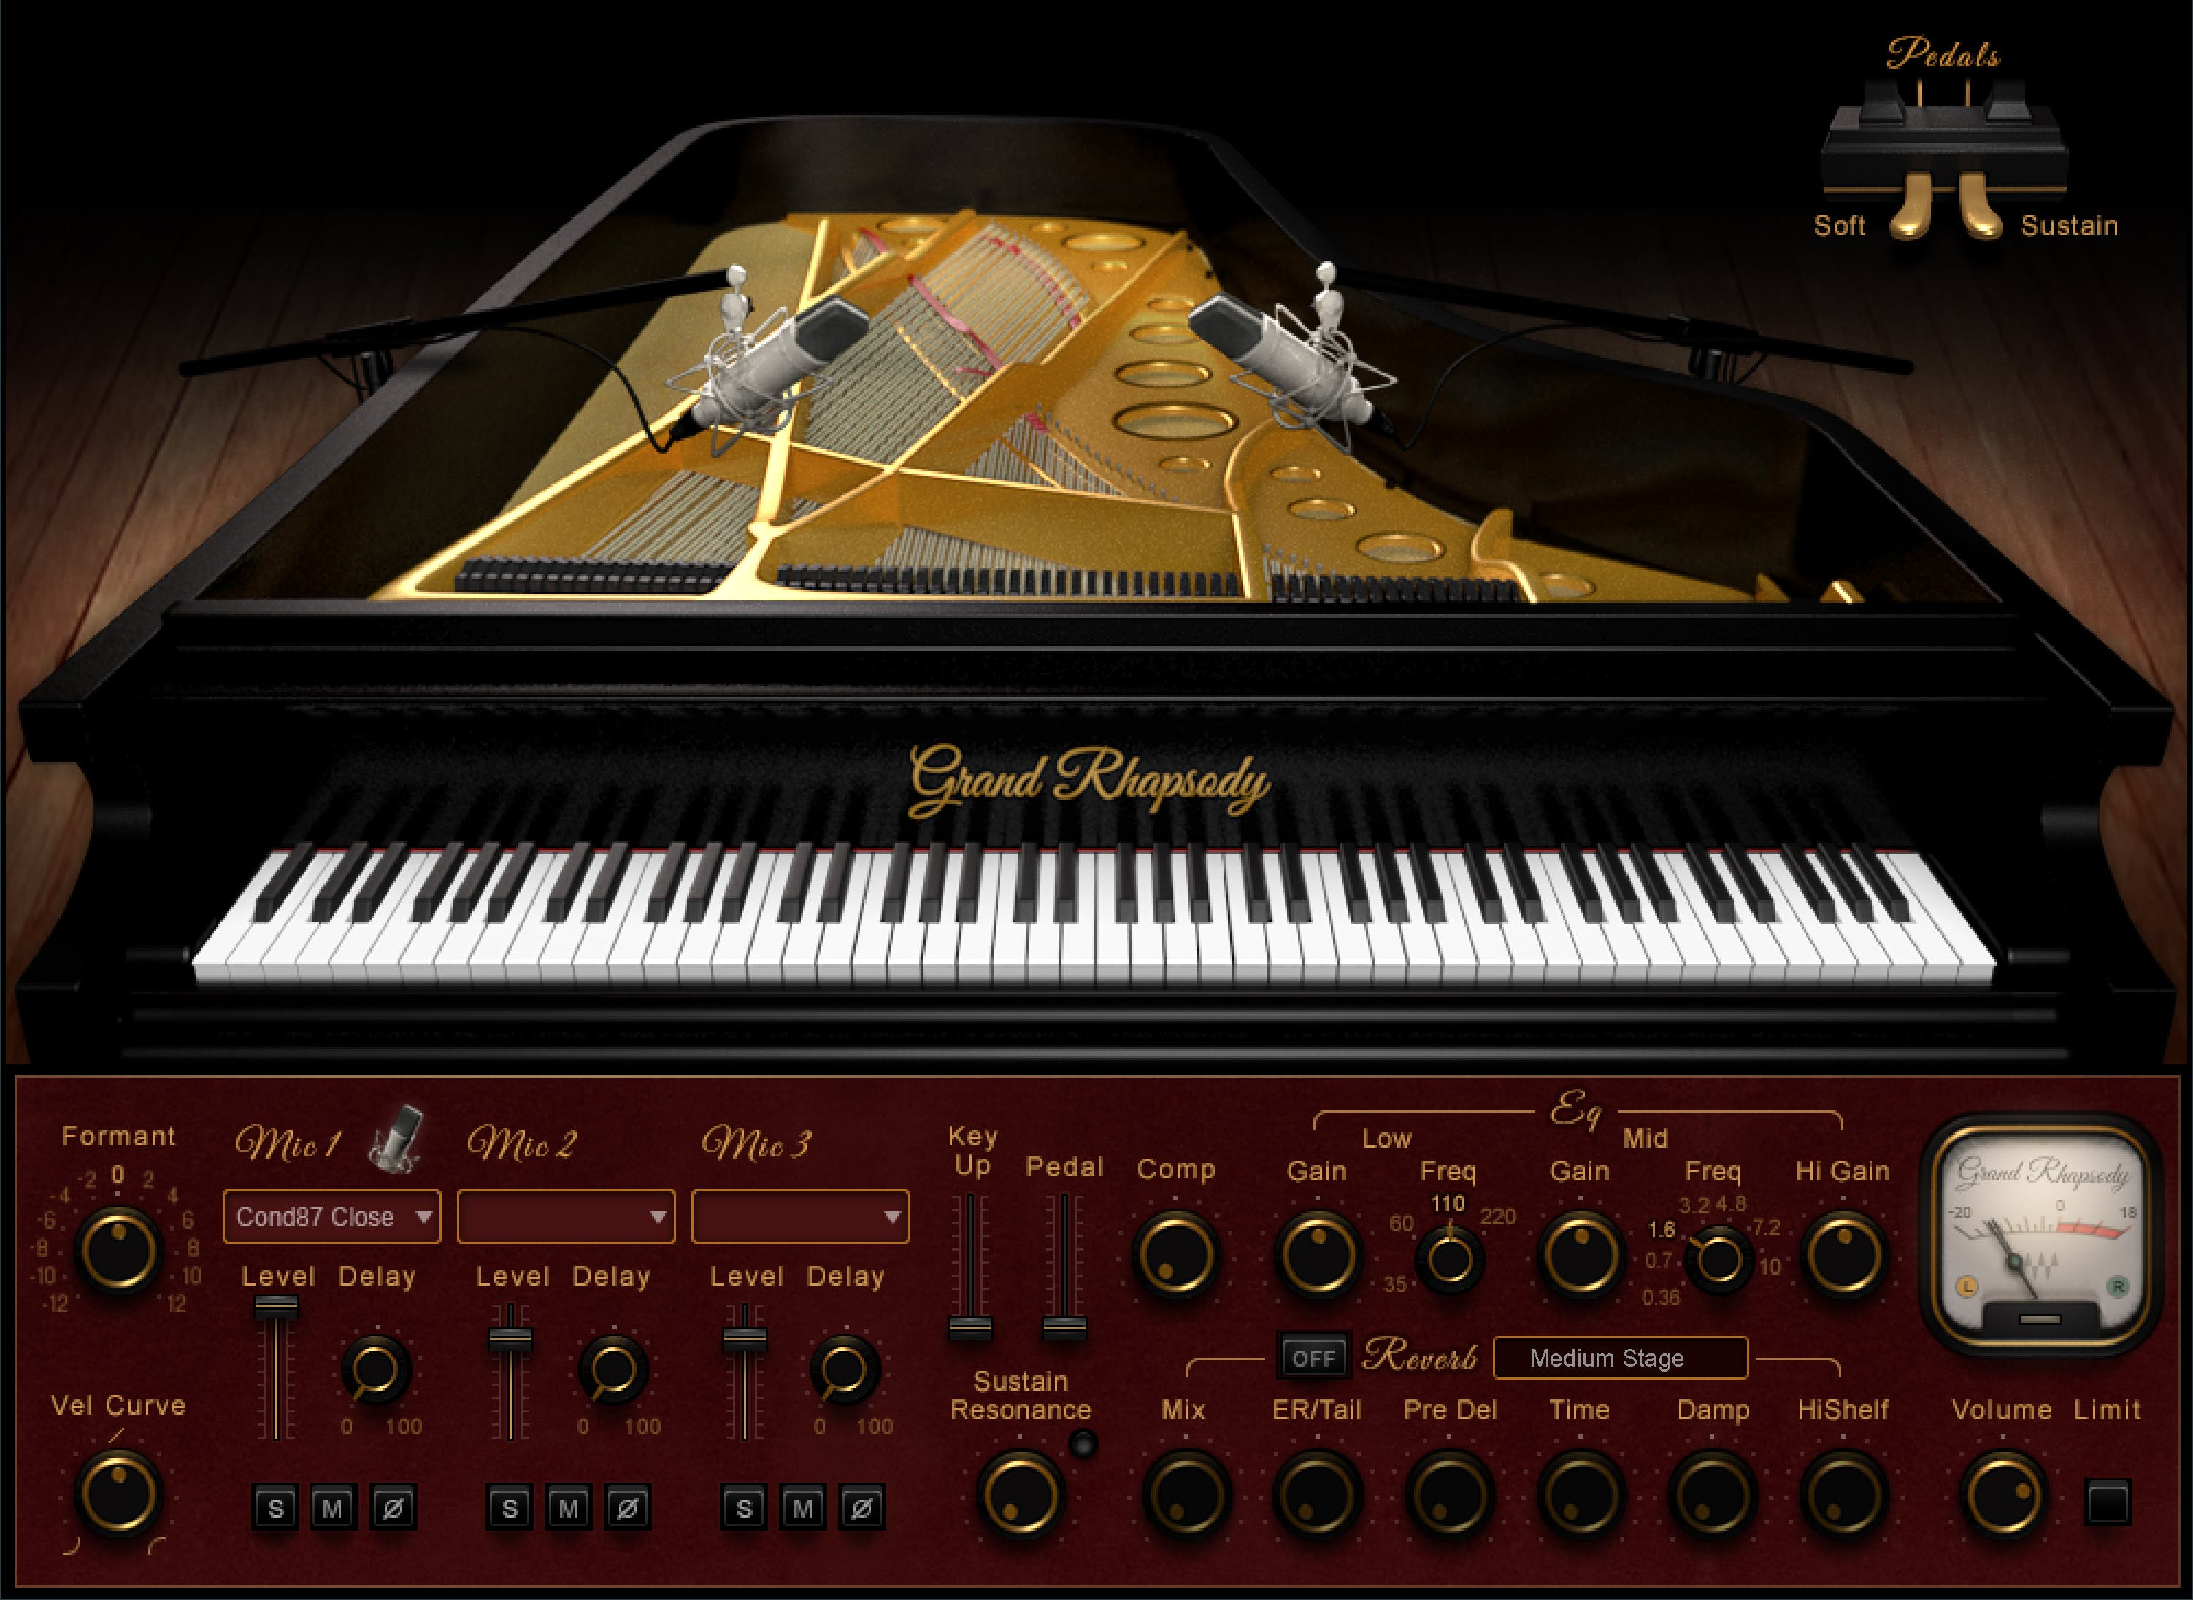
VST Instrument (VSTi)
VST Instrument plugins generate audio
Can act as standalone software synthesizers, samplers, or drum machines
Often emulate look & sound of hardware synthesizers and samplers
lets musicians and recording engineers use virtual versions of devices that otherwise might be difficult to obtain
MIDI messages control instrument parameters
Receive musical notes as digital information via MIDI
Output digital audio
Some effect plugins also accept MIDI input
for example, MIDI sync to modulate the effect in sync with tempo
Notes:
VST Instrument plugins generate audio
Can act as standalone software synthesizers, samplers, or drum machines
Often emulate look & sound of hardware synthesizers and samplers
lets musicians and recording engineers use virtual versions of devices that otherwise might be difficult to obtain
MIDI messages control instrument parameters
Receive musical notes as digital information via MIDI
Output digital audio
Some effect plugins also accept MIDI input
for example, MIDI sync to modulate the effect in sync with tempo

Slide 10
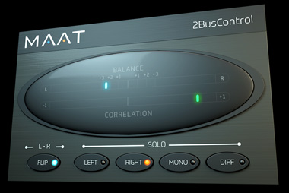
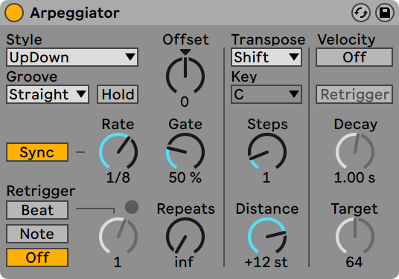
Other VSTs
VST Monitoring effects
Special type of VST effect
Provide feedback about input signal without processing audio
Audio monitoring devices represent audio characteristics visually
Spectrum analysers: frequency distribution
Meters: amplitude
VST MIDI effects
process MIDI messages (for example, transpose or arpeggiate), and
route MIDI data to other VST instruments or hardware devices
Notes:
VST Monitoring effects
Special type of VST effect
Provide feedback about input signal without processing audio
Audio monitoring devices represent audio characteristics visually
Spectrum analysers: frequency distribution
Meters: amplitude
VST MIDI effects
process MIDI messages (for example, transpose or arpeggiate), and
route MIDI data to other VST instruments or hardware devices

Slide 11
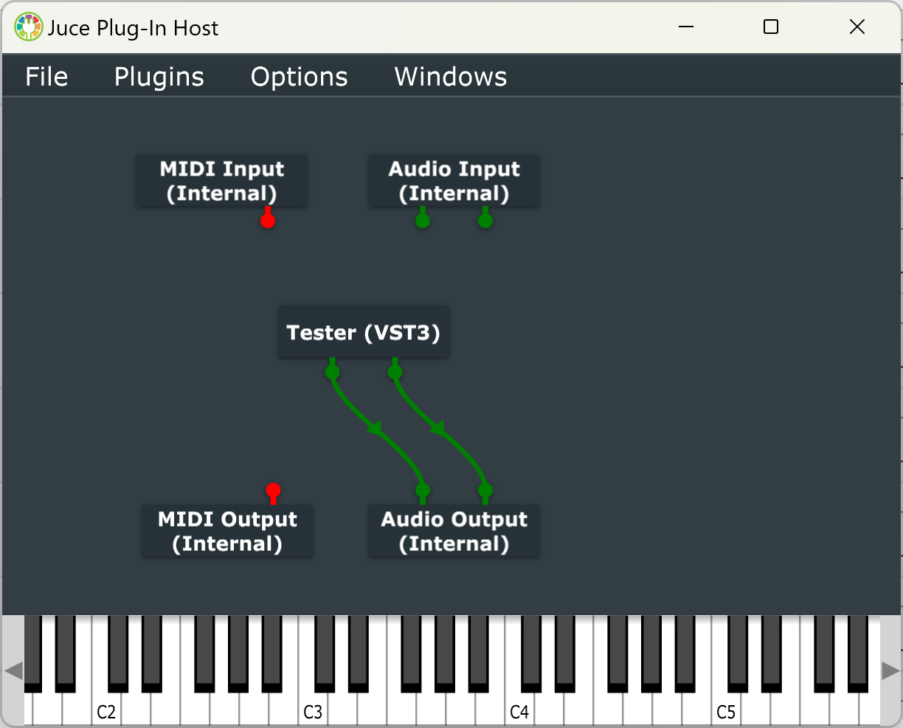
VST Host
software application or hardware device in which VST plugins run
presents plugin UIs and routes digital audio & MIDI to and from plugins
Stand-alone hosts provide environment for VST plugins
Often optimized for live performance use
Hardware VST hosts can load special versions of VST plugins
portable & usable without computer, though some require computer for editing
either
run music applications like Cubase, Live, Pro Tools, Logic etc.
run their own DAW
require separate DAW application
Notes:
VST Host
software application or hardware device in which VST plugins run
presents plugin UIs and routes digital audio & MIDI to and from plugins
Stand-alone hosts provide environment for VST plugins
Often optimized for live performance use
Hardware VST hosts can load special versions of VST plugins
portable & usable without computer, though some require computer for editing
either
run music applications like Cubase, Live, Pro Tools, Logic etc.
run their own DAW
require separate DAW application

Slide 12
What we will do
Learn audio processing and programming concepts
Learn how to process audio samples and MIDI
Use JUCE to develop VST plugins and standalone applications in C++
Prototype and deploy different audio effects, filters, instruments and generators

